Slide 1
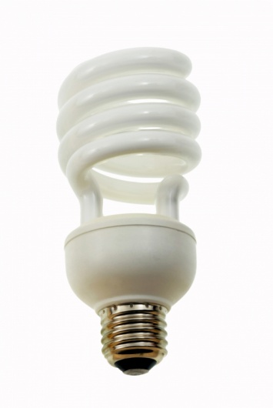
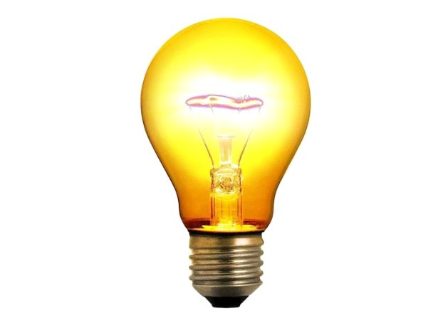
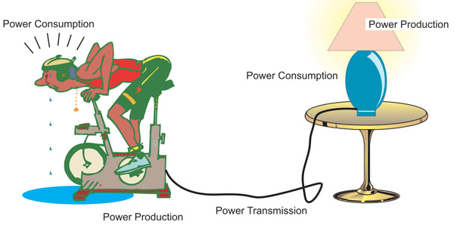
Power & Efficiency

Slide 2
Part I - Power

Slide 3
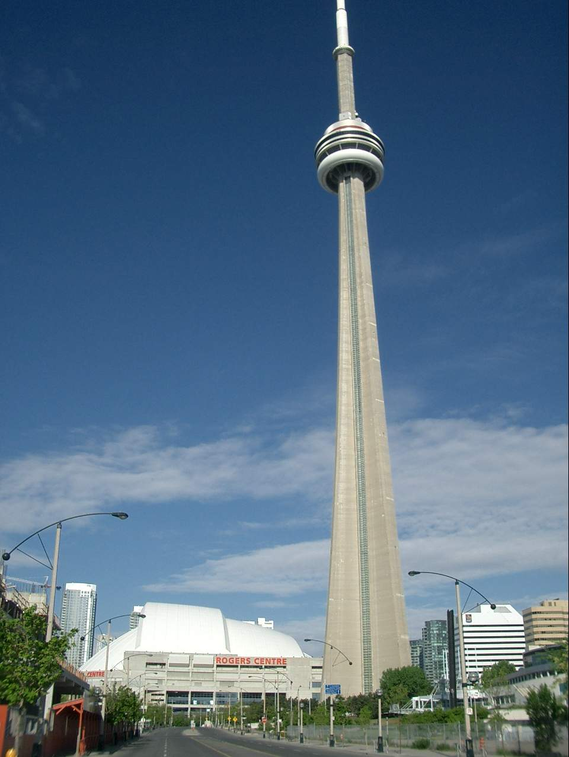
Power
POWER: the rate of doing work or transforming
energy
Example: Two students (both mass 65 kg) run up the CN tower (342m high) in the CN stair climb. Student A finishes in 16 minutes and student B finishes in 22 minutes.
Who exerted more power?
Both have done the same amount of WORK
To increase their gravitational potential
energy!!
Student A has done the work faster!!!
We say that A is more POWERFUL!

Slide 4


POWER: the rate of doing work or transforming
energy
OR
Units of Power: Joules/Second or Watt
1 J/s = 1 Watt
1 Watt is a very small power output! We commonly use a larger unit of kilowatt
1 kW = 1000 W

Slide 5
Back to our example…
Two students (both mass 65 kg) run up the CN tower in the CN stair climb. Both climb a distance of 342 m but student A finishes in 16 minutes and student B finishes in 22 minutes.
How much power did each student develop?
Work done = ∆E_{g}= mg∆h
Answer: Power Student A = 2.27 x 10² W,
Power Student B = 1.65 x 10 ² W

Slide 6
Sample Power Questions
What is the power of an elevator motor if it uses 2.9x10⁵ J to lift an elevator car one story in 16 s?
P = ΔE / Δt
P = 2.9x10⁵ J / 16 s = 1.8x10⁴ J/s = 1.8x10⁴ W
If a 60 W light bulb is left on for ten hours (3.6x10⁴ s), how much energy is transformed?
P = ΔE / Δt or ΔE = P x Δt
ΔE = 60 W x 3.6x10⁴ s = 2.2x10⁶ J

Slide 7
Part II - Efficiency

Slide 8
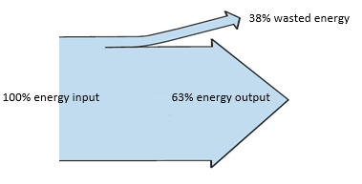
Efficiency: every device when it transforms energy “wastes” energy by converting it into unwanted forms
e.g. a light bulb produces waste heat
62%

Slide 9
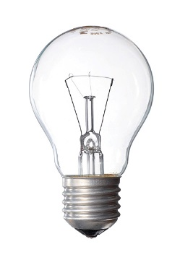
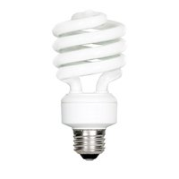
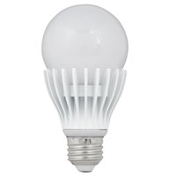
No real system is 100% efficient
Some percentage of energy is always converted to an non-useful form
E.g. Noise, heat, friction, etc.
For example, A standard light bulb
95% energy wasted as heat
Only 5% useful light
A compact fluorescent light bulb is better
20 % useful light, 80% wasted heat
Led light bulbs are the future
75 % useful light, 25% wasted heat

Slide 10


Efficiency: of a device is the ratio of the useful energy output to the energy input
*Note: E_{out} is always less than E_{in}

Slide 11
Example:
A fluorescent light bulb converts 180 J of input electrical energy into 36 J of radiant energy. What is the percent efficiency of a fluorescent light bulb?

Slide 12
Efficiency Questions
Fireflies use chemical energy to create a glow in their abdomen. What is a firefly’s efficiency if it transforms 4.13 J of chemical energy into 3.63 J of radiant energy?
efficiency = 87.9 %
What is the efficiency of a pulley system if 1.93x10³ J of mechanical energy is used to lift a 20 Kg mass to a height of 7.5 m?
efficiency = 76.3%

